Slide 1

Detecting Key Contributing Factors of Death
For Heart Failure Patients Who were at Risk of Death upon Readmission using Machine Learning
A Project for
Project Members:
Goh Pei Xuan
Li Yiqi
Yao Zhihao
Yeo Yuan Kai
Zeng Jing
Zheng Dongdong
Notes:
Intro teammates
State Agenda – Here to talk about how we can use machine learning to assist NHC in detecting key factors contributing to death for heart failure patients who were at risk of death upon readmission

Slide 2




Overview
Identify
Recommendations
Area that could be improved with AI
Current
Modelling
Leveraging on AI models to improve efficiency
What the current situation is
Presenting AI models
Notes:
Problem statement
Cardiovascular disease… leading cause of death… 32% of all deaths in Singapore in year 2021……
Models and approach
Using 3 models – LR, DT & RF to tackle this problem.
Why? Predicting death, which is a categorical variable with 2 outcomes.
These 3 models are highly efficient in making a prediction and often used for predicting categorical variables
Move to current situation (next slide)

Slide 3
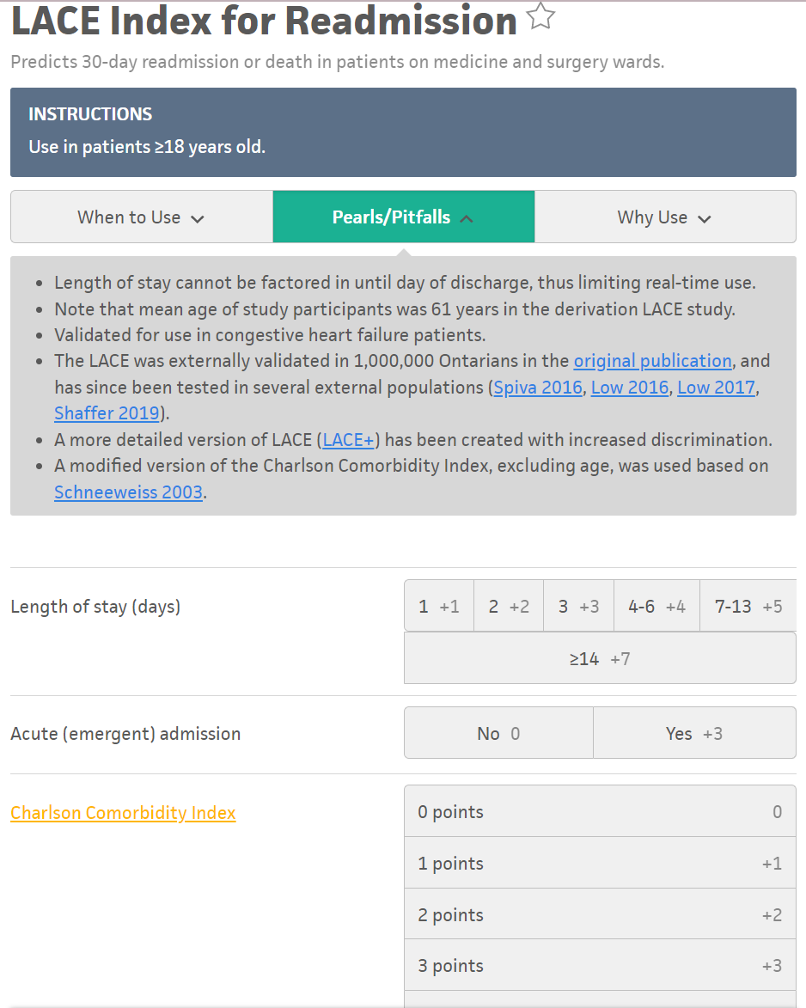
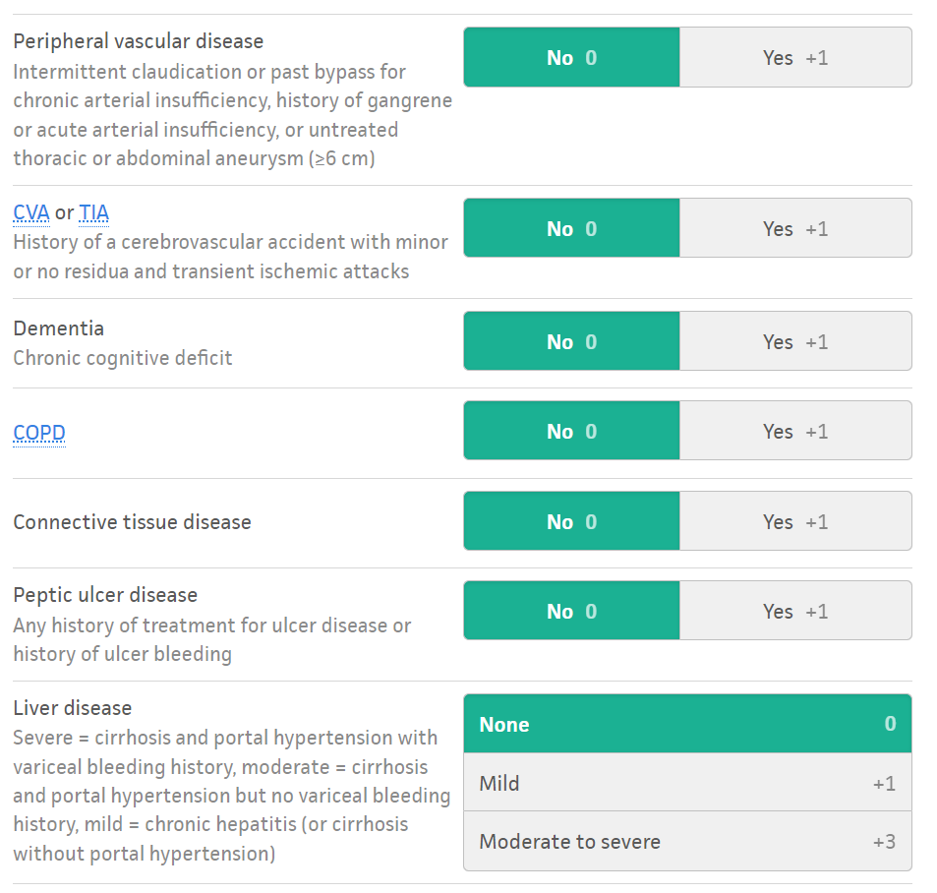
Present/Current Situation
Current Solutions in Place:
Heart Failure Programme in National Heart Centre Singapore (NHCS)
aims to improve the quality of life and survival for heart failure patients and reduce the number of re-hospitalisation through our multidisciplinary team based approach. The team comprises heart failure Cardiologists, Cardiothoracic Surgeons, Nurse Clinicians, Physiotherapists, Dieticians, and Pharmacists.
LACE Index for Readmission
Notes:
Current situation – LACE Index for readmission
NHCS – Multidisciplinary team based approach
LACE requires doctors/nurses to input a variety of patient conditions. This can be labor intensive, especially if a patient visits different hospitals for their medical conditions.

Slide 4




area Identified for Improvement
Improve patients' outcome; Improve workflow efficiency
Lower operation costs and mortality rate
By identifying heart failure patients with high-risk of death after readmission and effectively allocate resources to tend to this group of patients
Frequent rehospitalization is a hallmark of chronic heart failure (HF). From various research , we understand that rehospitalization and mortality rates tended to be higher among Asian patients – patients of the National Heart Centre
Multiple comorbidities among patients with HF may have been factors contributing to rehospitalization and consequently death upon readmission.
Such situations are costly for both the patients whose health is deteriorating and the Centre which requires large amount of medical resources/manpower to tend to patients with complex health needs
Early identification of high-risk patients/profiles can help prevent this situation and allow effective allocation of manpower and resources to tend to these patients & improve patient outcome
Notes:
How we want to improve the current solutions
We plan on using our machine learning model to
Improve patient’s outcome
Improve workflow efficiency
Lower operation costs and lower mortality rates
How?
Identify high risk heart failure patients with the least amount of effort
Effectively allocate resources to tend to this group of patients

Slide 5
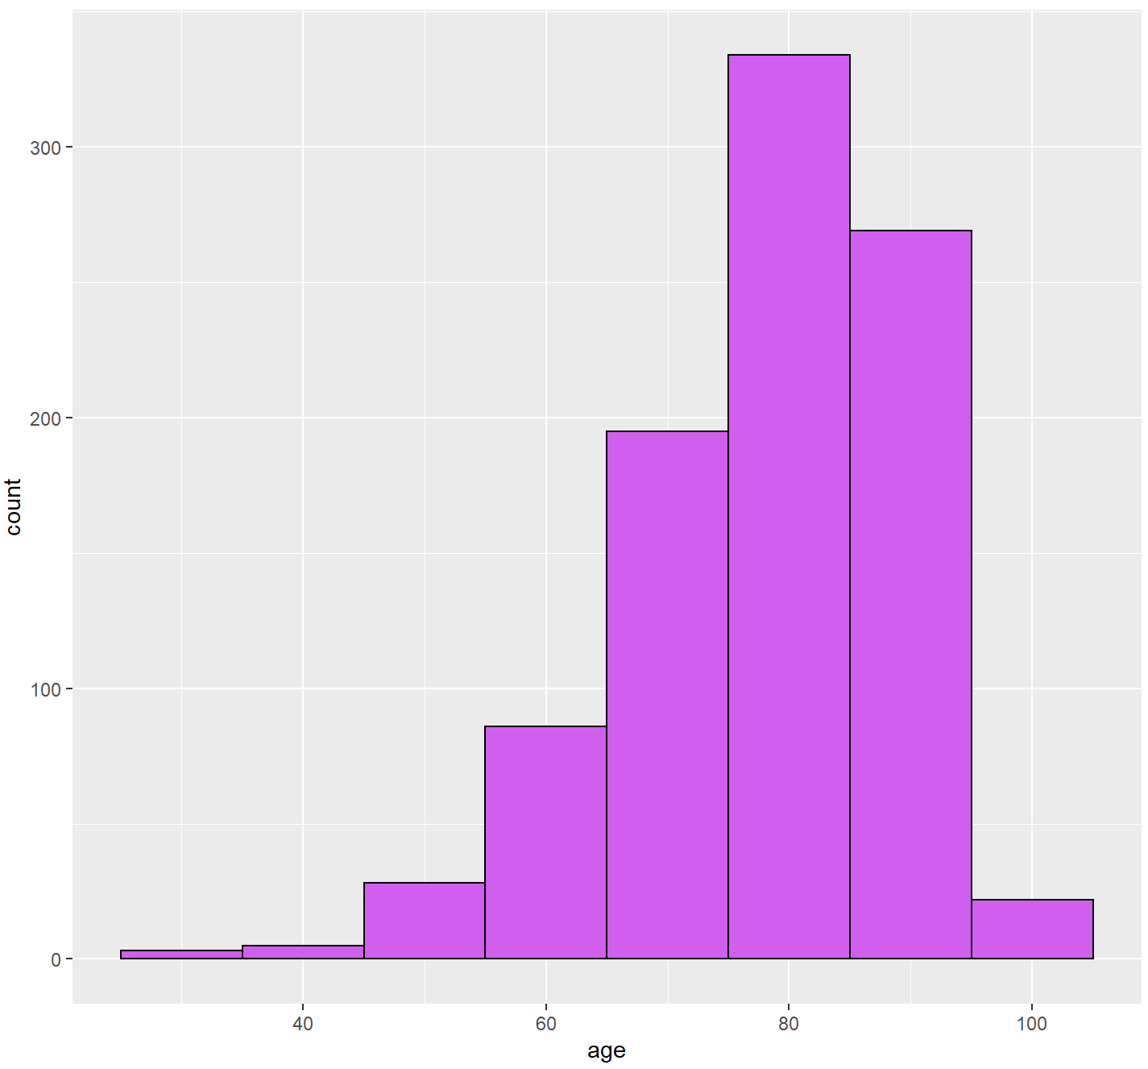
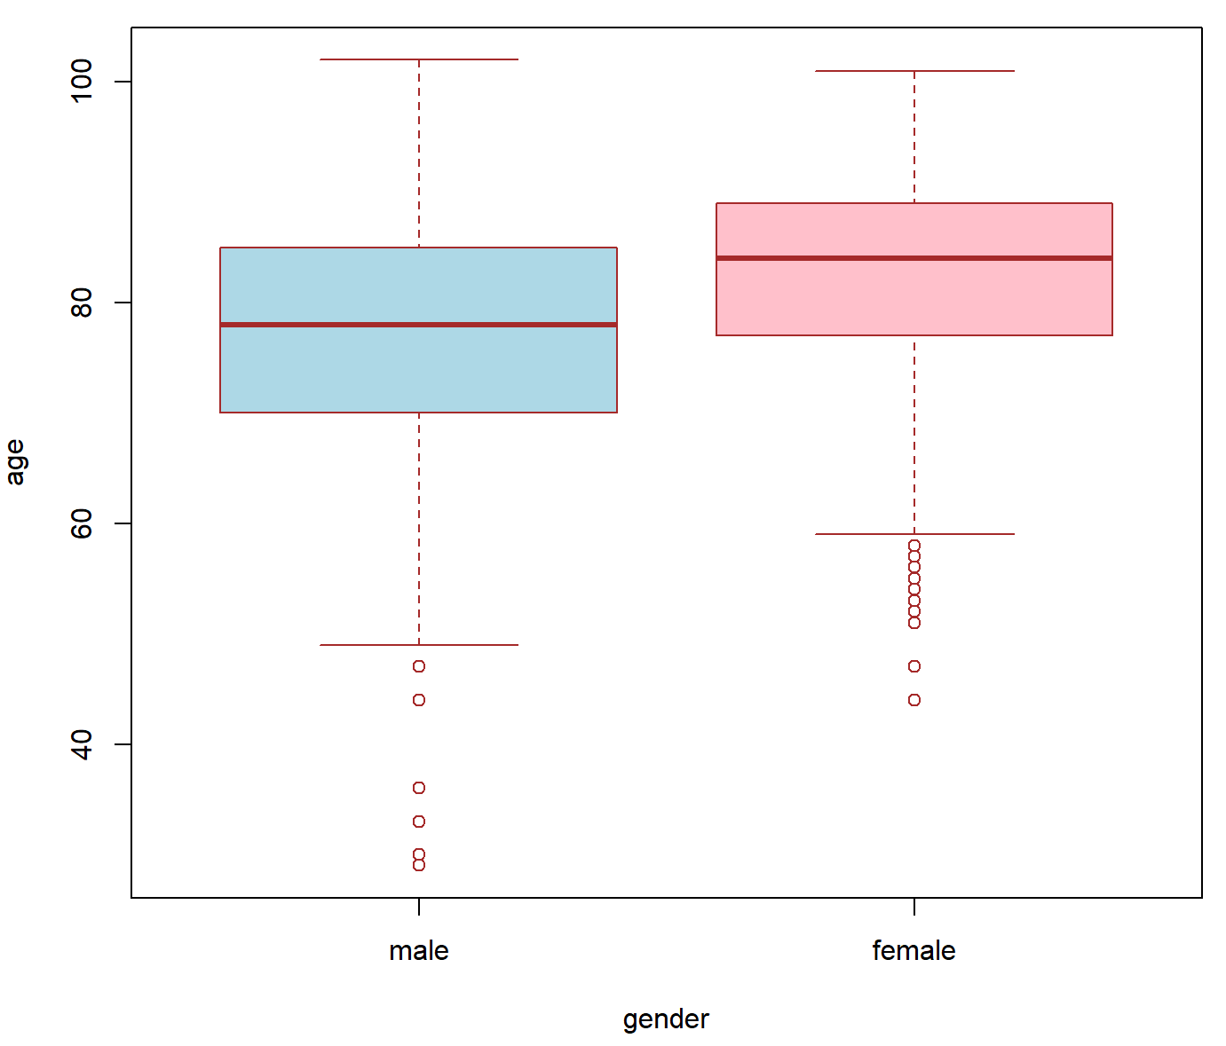
Present/Current Situation
Data exploration/visualisation
Demographic profile of patients in general:
Mostly elderly with a median age of 80 years old
Relatively equal mix of both genders; female patients tended to be older (avg =84 years old) than male patients (avg = 78 years old)
Overview of age profile
Avg age of male vs female
102
101
84
78
59
49

Slide 6
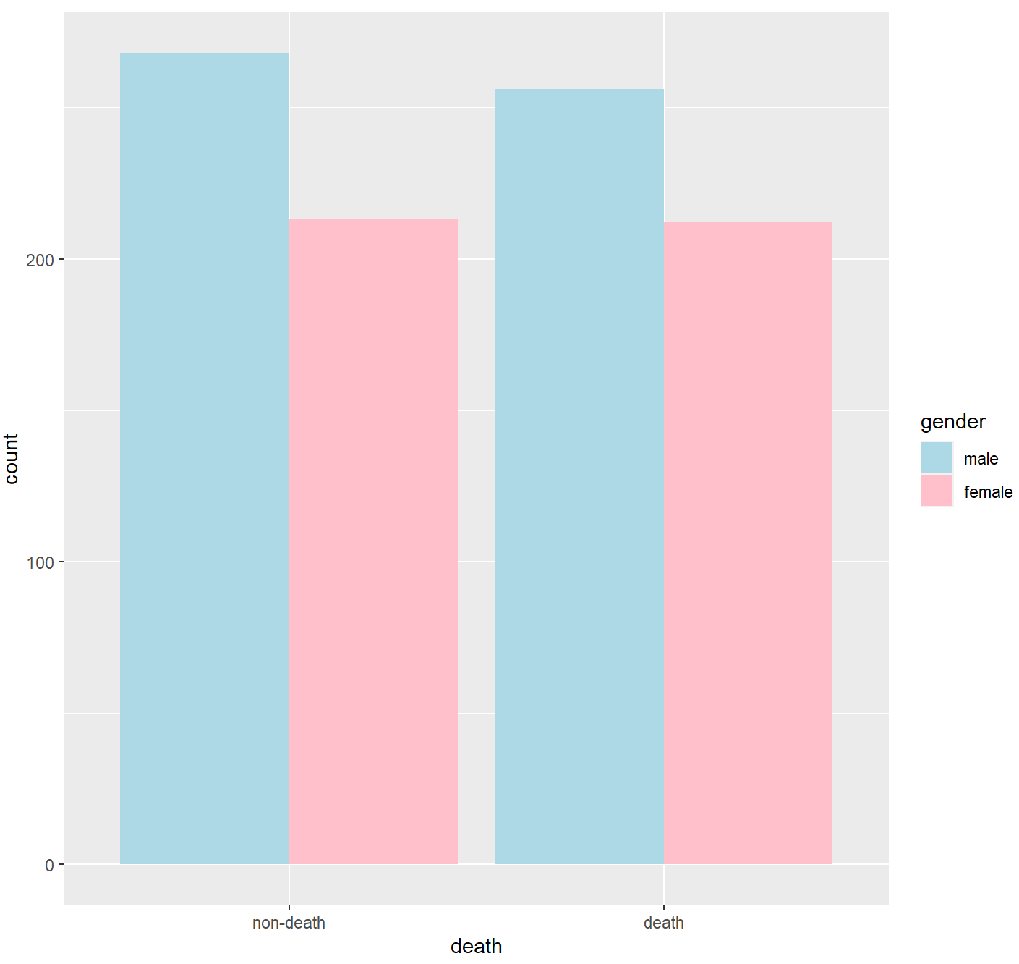
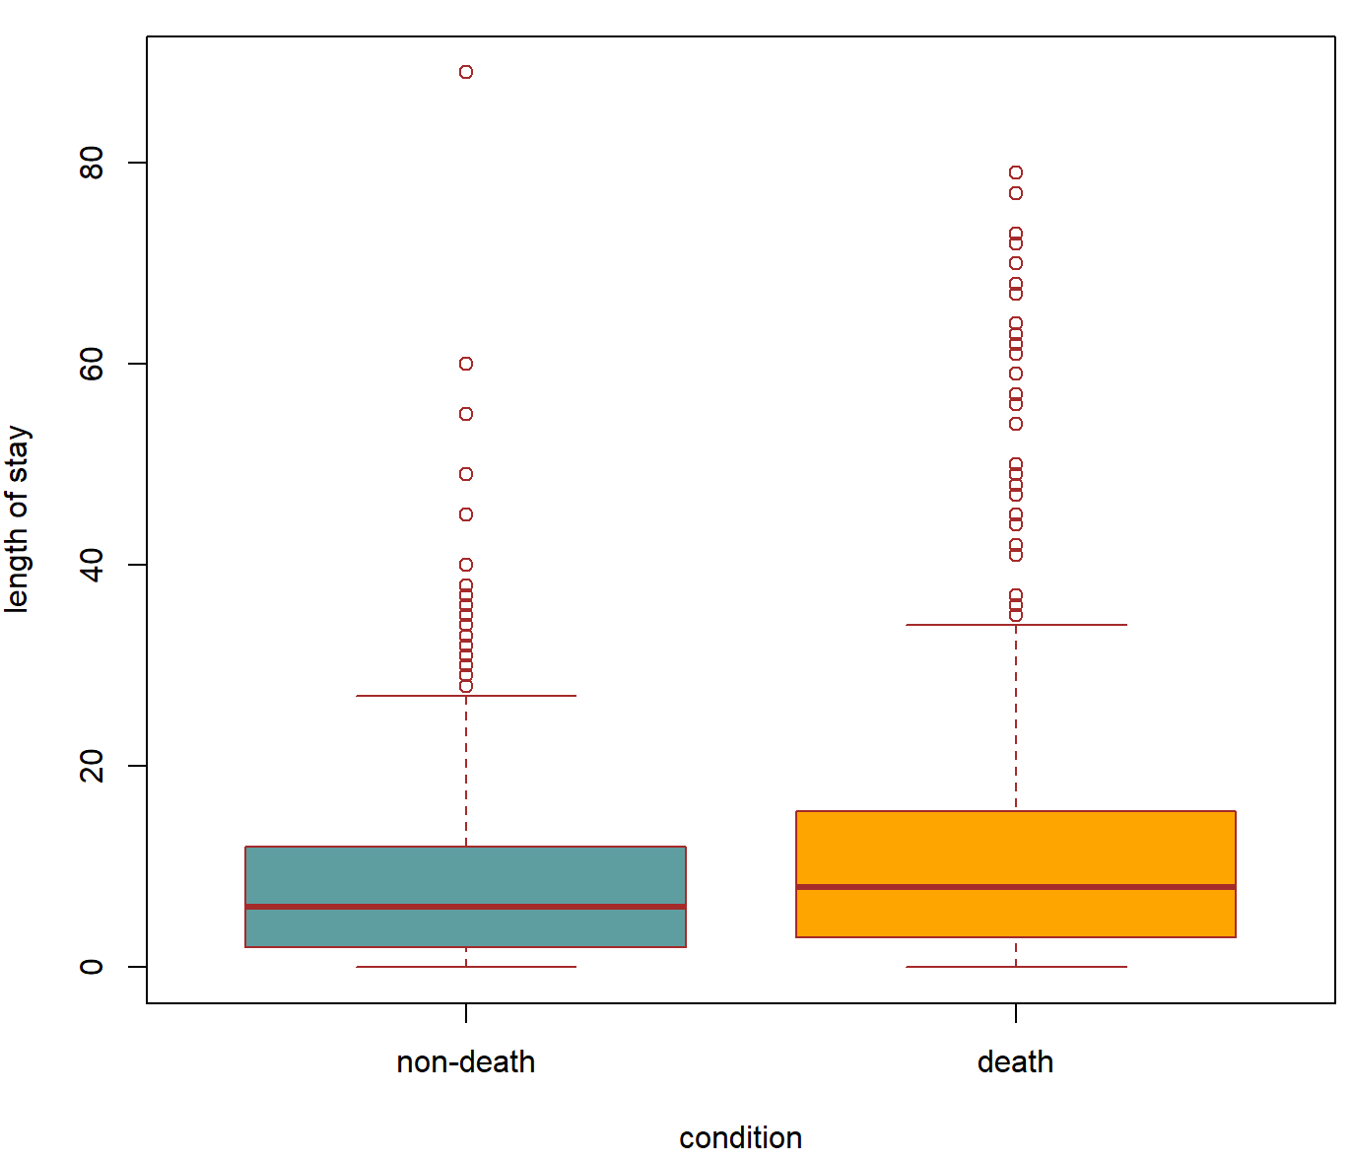
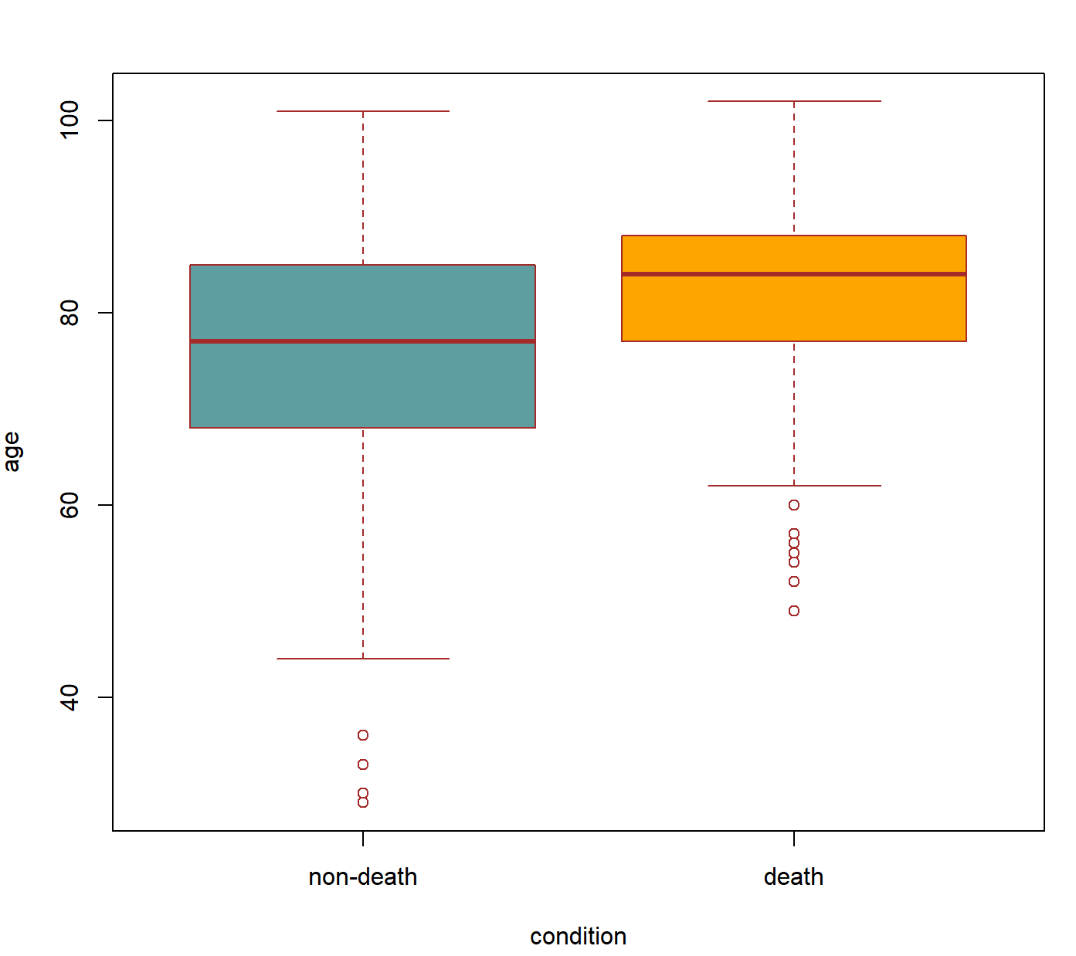
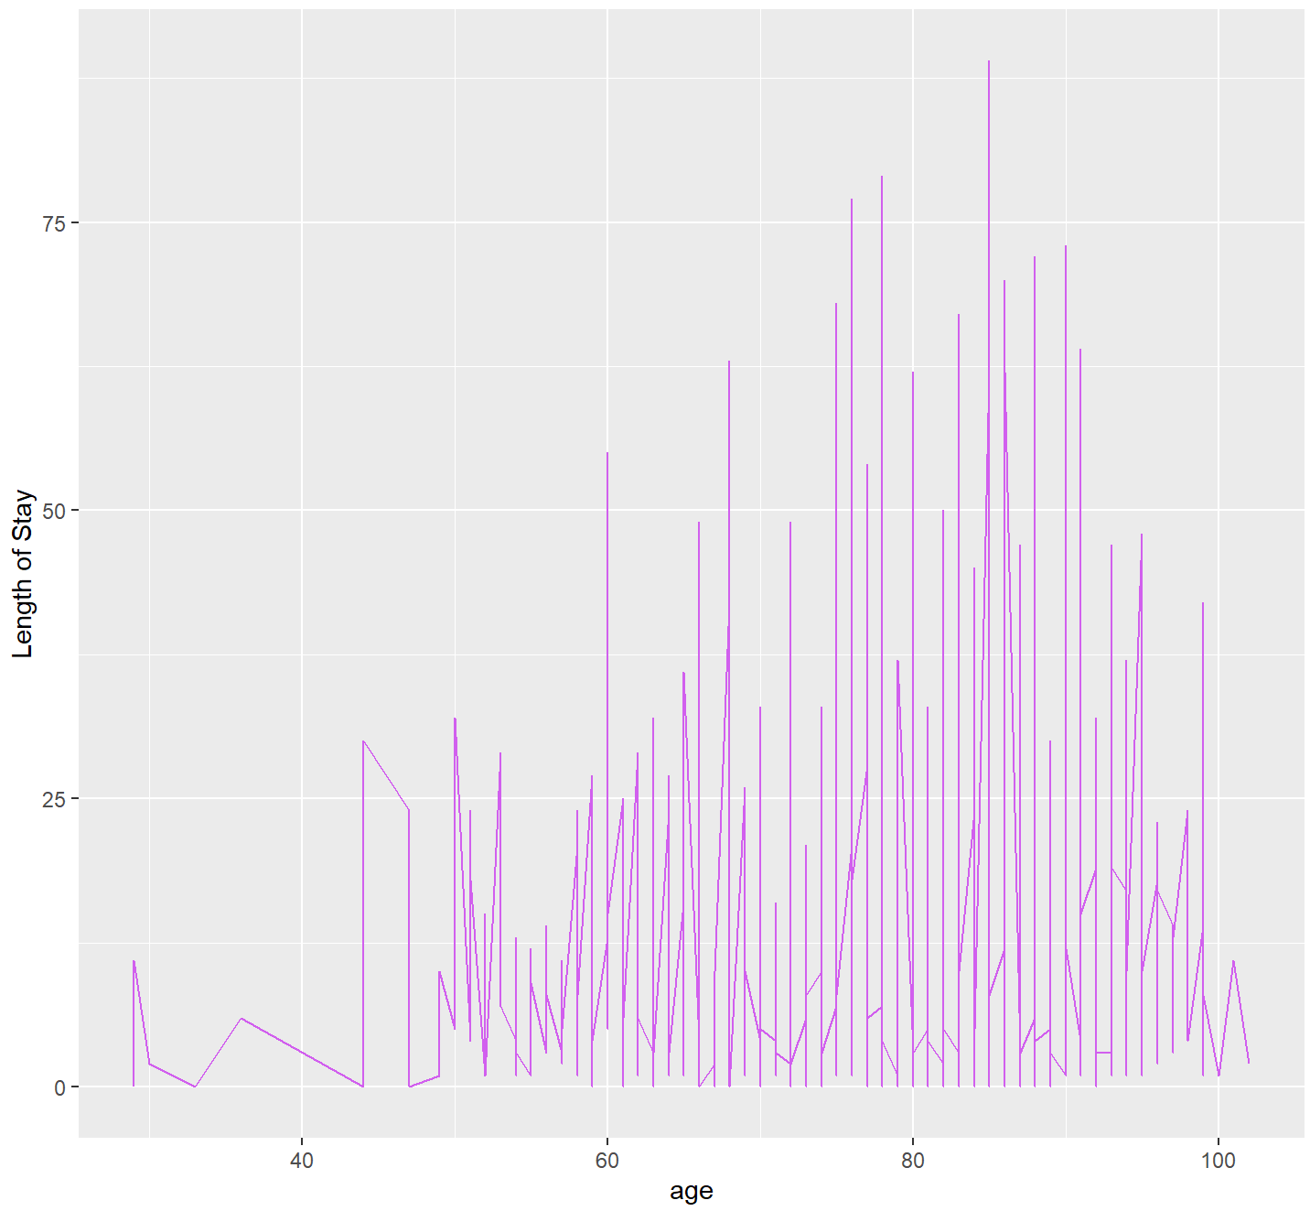
Present/Current Situation
Data exploration/visualisation
Comparison of profile of patients who passed on vs. discharged:
Relatively equal mix of both genders who passed on or got discharged
Patients who passed on (avg = 84 years old) tended to be of greater age than those who got discharged (avg = 77 years old)
Patients who passed on (avg = 8 days) tended to have a longer length of stay in the hospital than those who were discharged (avg = 6 days)
However, no clear, distinctive pattern between age and length of stay was found
Prop of gender
Avg LOS of patients
27
34
Avg age of patients
6
8
LOS & Age
101​
102
84
77
62
44​

Slide 7
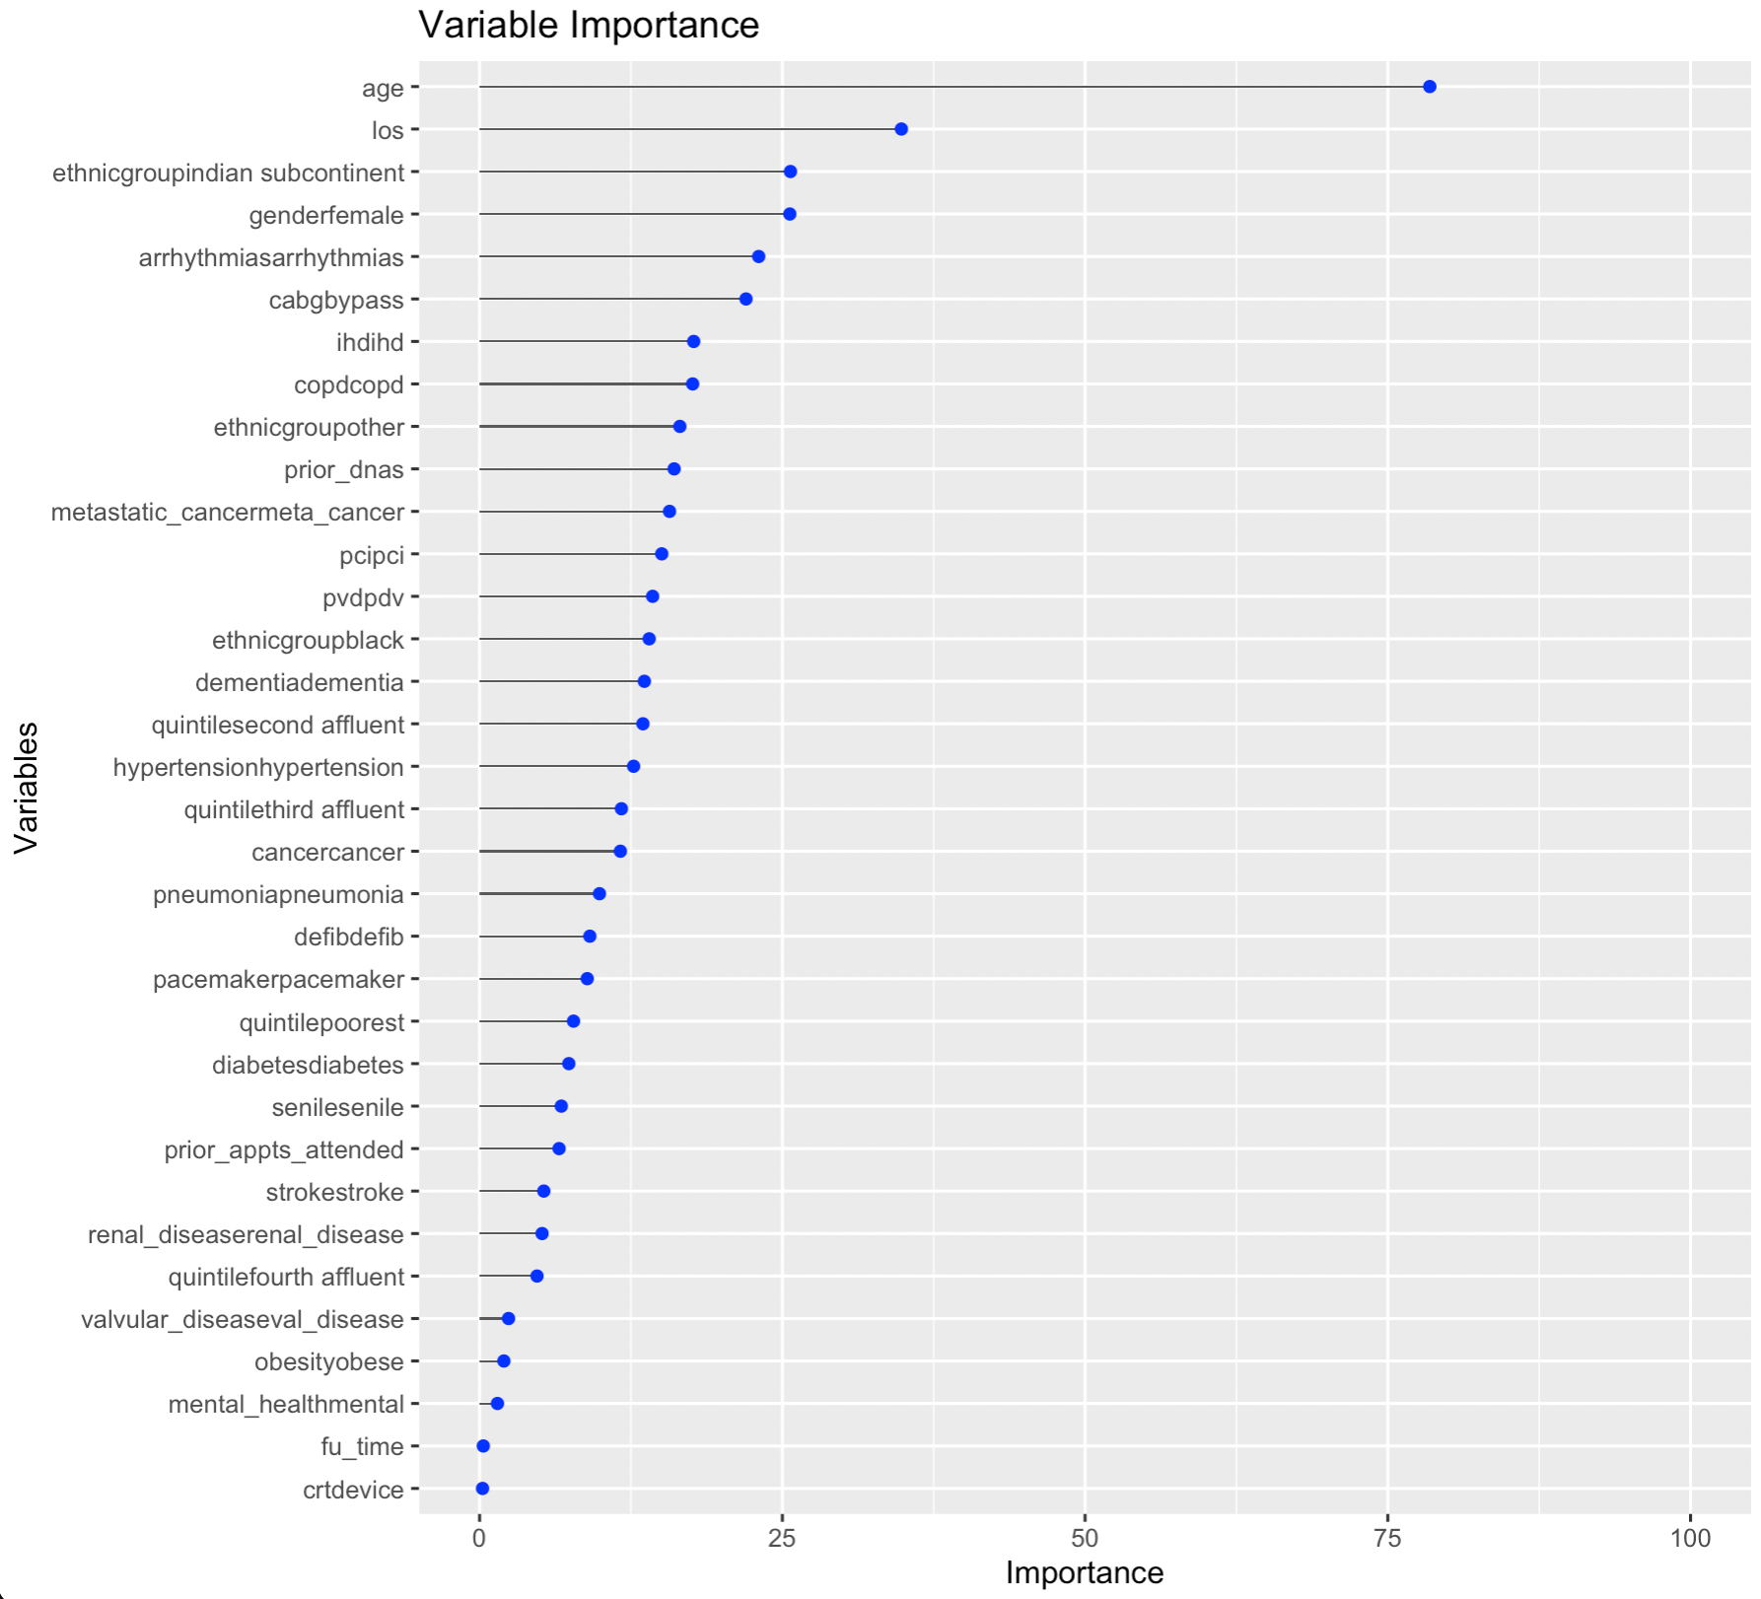
Modelling – Logistic Regression
Log regression
Firstly, we use all features to build the logistic regression and finally get the accuracy rate: 64.08%, which is the highest score we get among the three models. However, more features don’t necessarily mean the better model performance, some of them are useless to interpretate the model.

Slide 8
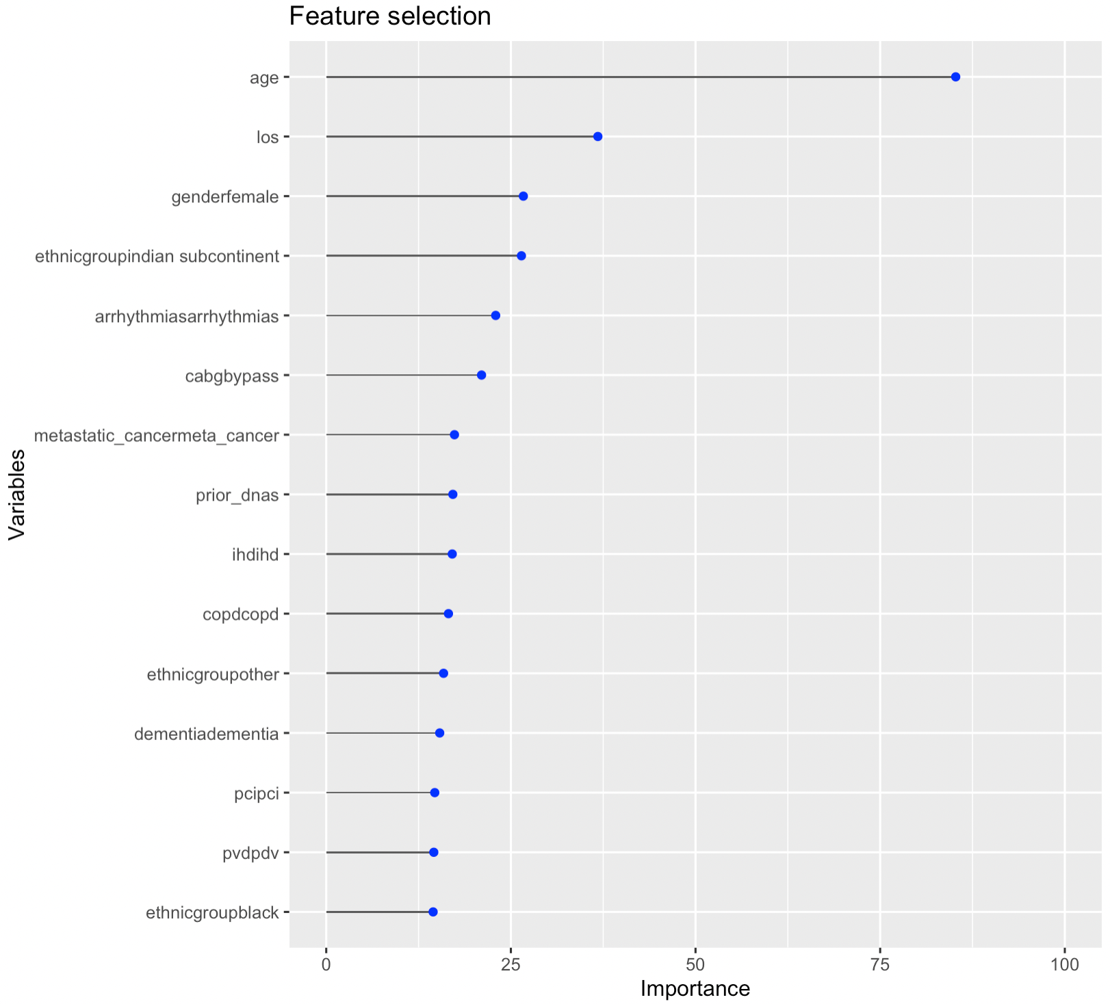
Modelling – Logistic Regression
Log regression
Feature Selection
Accuracy
66.20% > 64.08%
After doing stepwise selection, we get 13 features remaining: los, age, gender, cabg, dementia, ihd, arrhythmias, copd, pvd, metastatic_cancer, prior_dnas, pci, and ethnicgroup.
Feature selection indeed improves the model performance

Slide 9
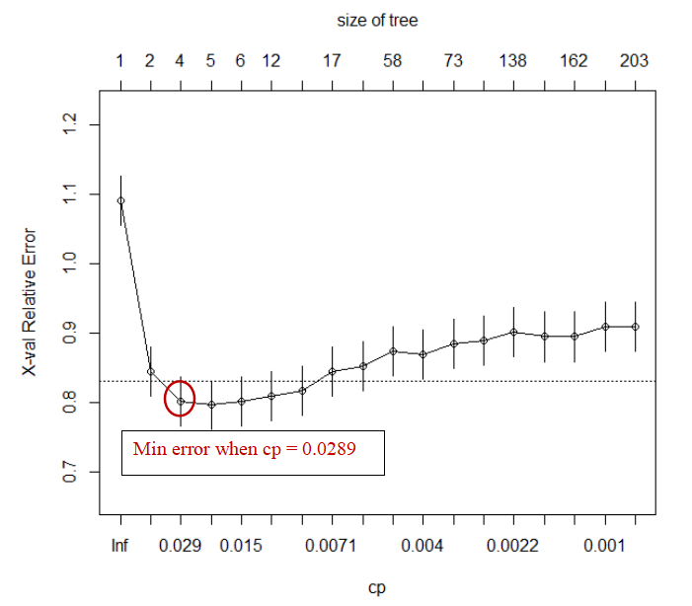
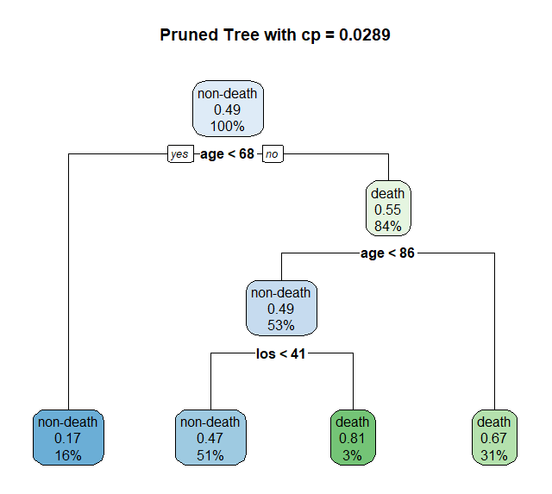
Modelling – Decision Tree
Tree model
Find cp with minimum error
Get optimal decision tree
Grow the decision tree to the maximum by producing all possible decision rules. However, some of the decision rules are barely contributing to better model performance.
Getting minimum 10-fold cross validation error when cp=0.0289, use it to grow optimal tree. There were 4 decision rules for determining whether the patient will survive or die after readmission.
Accuracy reaches 63.38%

Slide 10
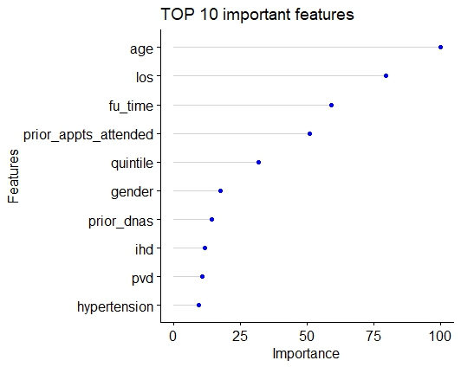
Modelling – Decision Tree
Tree model
Feature Importance
Based on the Decision Tree Model we found that Age, Los (hospital length of stay in nights)，Fu_time (follow-up time), Prior_appts_attended (number of outpatient appointments attended in the previous year) are four most important variables.

Slide 11
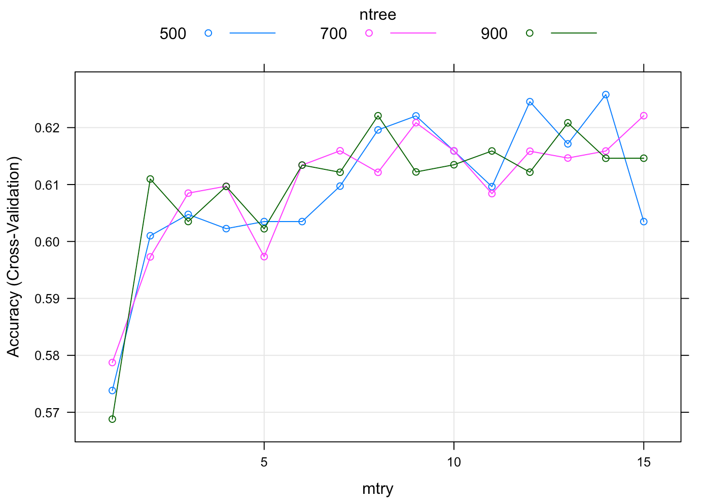








Modelling – Random Forest
Random forest model
Grid Search to Determine Parameter: mtry, ntree
Estimated Test Accuracy for Grid Search by 5-fold CV
BEFORE
AFTER
mtry = 5
mtry = 14
ntree = 500
ntree = 500
accuracy = 60.34%
accuracy = 62.57%

Slide 12
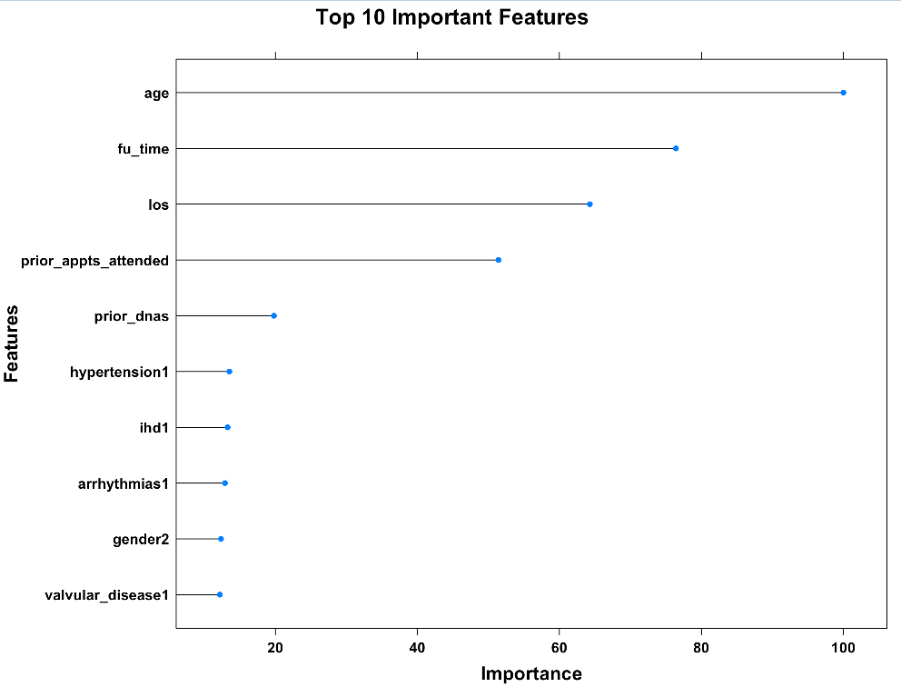
Modelling – Random Forest
Random forest model
Feature Importance
Based on the Random Forest Model we found that Age, Fu_time (follow-up time, i.e., time in days since admission to hospital), Los (hospital length of stay in nights), Prior_appts_attended (number of outpatient appointments attended in the previous year) were four most important variables.

Slide 13

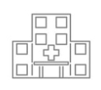

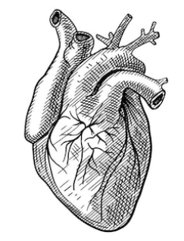


Summary of models
Logistic Regression gives highest prediction accuracy: 66.2%
Model | Test set Accuracy
Logistic Regression | 66.20%
Decision Tree | 63.38%
Random Forest | 62.58%
Features of Significance:
Age
Length of Stay (LOS)
Gender
Heart bypass (cabg)
arrhythmias
ethnicity
Also features of importance in decision tree and random forest

Slide 14
Recommendations
Prioritise care for patients based on the following factors:
(in order of importance)
1. Age and Previous length of stay
2. Patients with history of arrhythmias and/or had heart bypass surgeries
3. Gender & Ethnicity
To improve patient outcome and workflow efficiency,
while achieving low cost and mortality

